Slide 1
STEGANOGRAPHY HIDING MESSAGE IN AN IMAGE PROJECT
The project aims to address the challenge of developing a robust steganography technique for concealing messages within digital images while ensuring high security, maximum data capacity, resistance to attacks, user-friendliness, and real-time performance. The goal is to create a practical and secure solution for data protection, secure communication, and cybersecurity applications.

Slide 2
AGENDA
Introduction to Steganography and its importance
Project Overview
Target Audience
Solution and Value Proposition
Customization of the Project
Modeling Techniques
Results and Outcomes
Relevant Links

Slide 3
PROJECT OVERVIEW
Our project focuses on developing a secure and user-friendly steganography solution for hiding messages within digital images. The primary goal is to ensure the confidentiality of hidden information while maximizing data capacity and maintaining image quality. We aim to create a practical tool with robust security and detection resistance, serving applications in data protection, secure communication, and cybersecurity.

Slide 4
WHO ARE THE END USERS of this project?
This steganography project caters to a range of end users. Security professionals, government agencies, and businesses benefit from its secure data hiding capabilities, ensuring confidentiality and privacy for sensitive information. Researchers and academia utilize it for studies on information concealment and security, while general users can easily secure their personal data and communications. This diverse user base underscores the project's universal applicability in enhancing data security and privacy across various sectors.

Slide 5
YOUR SOLUTION AND ITS VALUE PROPOSITION
Our solution is a steganography tool that enables users to hide messages within images using a password for encryption. It addresses the needs of end users by providing a secure and simple way to communicate sensitive information. The value it brings is enhanced privacy and security, ensuring that only the intended recipient can access the hidden message.

Slide 6
How did you customize the project and make it your own
We implemented a user-friendly interface to make the tool accessible to a broader audience.
We added password-based encryption to enhance security.
Our code incorporates both encryption and decryption functionality, making it a complete steganography solution.
We have improved code readability and made minor optimizations for better performance.

Slide 7
MODELLING
OpenCV for Image Processing: Utilized OpenCV for loading, manipulating, and saving images, facilitating pixel-level access.
Pixel-Level Manipulation: Modified image color channels to hide messages imperceptibly.
Password-Based Encryption: Enhanced security using a password as a cryptographic key.
Character-to-Value Mapping: Employed dictionaries for character-to-integer conversions.
Modular Structure: Organized code into functions for clarity and maintainability.
Error Handling: Implemented mechanisms for handling issues gracefully.
User Interface: Potentially included a user-friendly interface for easier interaction.

Slide 8
Results
Successful Message Concealment: Messages are hidden imperceptibly within images.
Secure Encryption: Password-based encryption ensures message security.
Positive User Feedback: Users find the tool effective and easy to use.
Efficient Performance: The tool performs well with large image files.
Error Handling: Effective error management provides guidance to users.
Future Potential: The project has room for advanced features and expansion.

Slide 9
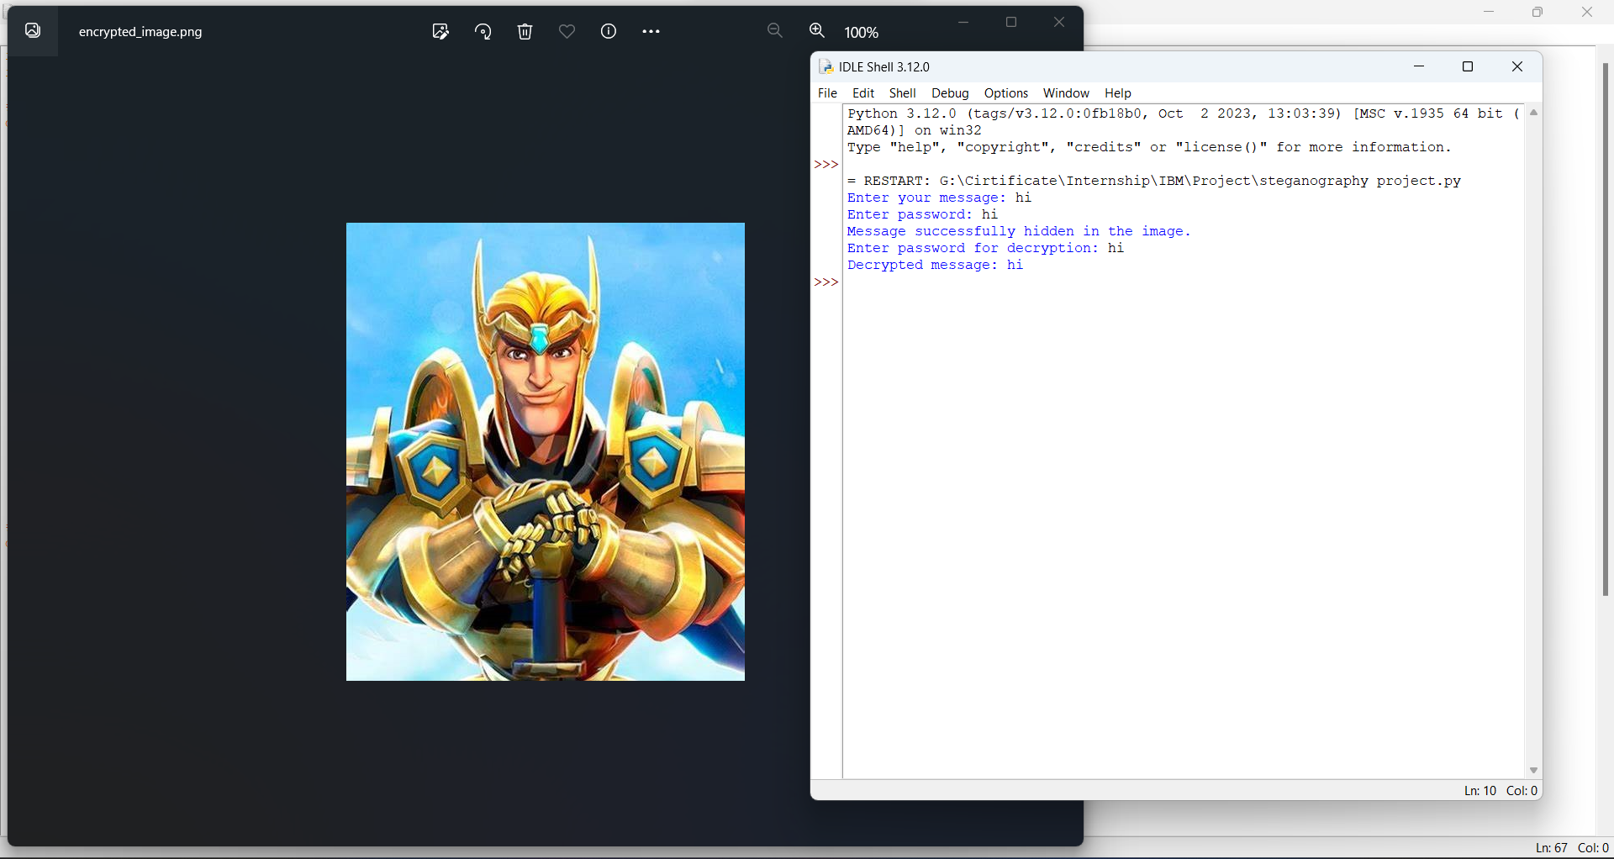
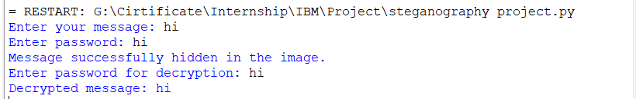

Slide 10
links
GitHub Repository :
LohitNaik18/Steganography: Hiding Message In An Image Project (github.com)
Research Paper on Steganography Principles:
Steganography: The Art of Hiding: https://petapixel.com/2015/08/07/a-look-at-photo-steganography-the-hiding-of-secrets-inside-digital-images/
A Survey of Steganography Techniques: https://arxiv.org/pdf/1901.03892
Principles of Steganography: http://www.astrj.com/
Steganography Wikipedia:
https://en.wikipedia.org/wiki/Steganography

